Slide 1
Email spam filter
By Asad Javed
SP19-BCS-104

Slide 2
Introduction
Email spam is also called junk email
It is unsolicited messages sent in bulk by email (spamming)

Slide 3
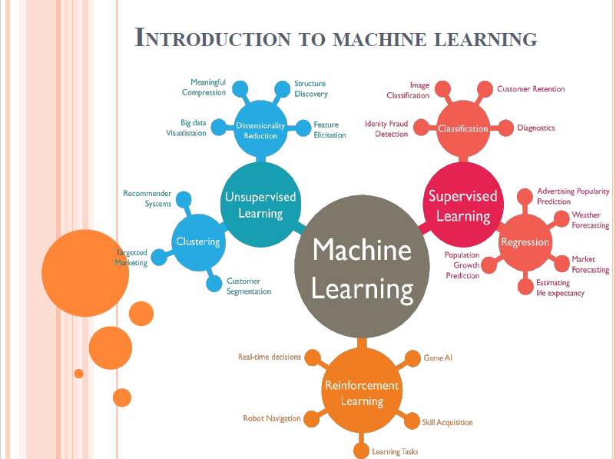
Machine Learning

Slide 4
TYPes
Supervised
Unsupervised
Reinforcement Learning

Slide 5
Supervised Machine learing
Classification
Output is Discrete (T/F)
Regression
Output is Continuous (Variable)

Slide 6
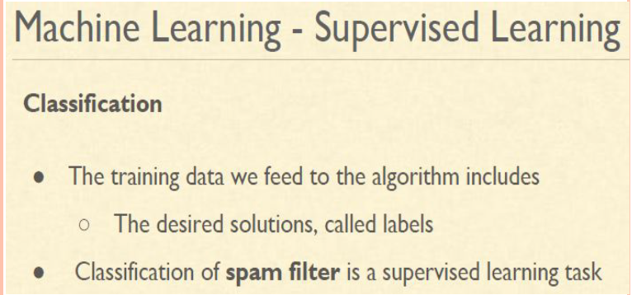
Classification

Slide 7
Methods
machine learning technique
Python programming language

Slide 8
ToOLs And Technologies
Google Collab
PyCharm
VS Code

Slide 9
Libraries
NLTK
Stopwords
Punkt

Slide 10
Steps
Spam filtering is document classification task which involves classifying an email as spam or non-spam mail
Preparing the text data.
Creating word dictionary.
Feature extraction process
Training the classifier

Slide 11
Preparing the text data
The data-set used will have to split into a training set and a test set
in text mining problem, text cleaning is the first step
Removal of stop words ; Stop words like “and”, “the”, “of”, etc . These are very common In English language and are not very meaningful in deciding spam or legitimate status

Slide 12
Creating word dictionary
A sample email in the data-set looks like this:
Subject: posting
hi , ' m work phonetics project modern irish ' m hard source . anyone recommend book article english ? ' , specifically interest palatal ( slender ) consonant , work helpful too . thank ! laurel sutton ( sutton @ garnet . berkeley . edu

Slide 13
Training the classifiers.
It is an open source python ML library
Naive Bayes classifier is a conventional and popular method for document classification problem.
It is a supervised probabilistic classifier based on Bayes theorem assuming independence between every pair of features.

Slide 14
Once the classifiers are trained, check the performance of the models on test-set
It will show the result (Ham or Spam)

